Slide 1
Bill & Monica: Sex, Lies & Videotape
Identity, Agency & Environment Dr. Gordon Wright

Slide 2
Dr. Gordon Wright
. . .
Lecturer in Deception, Mind-reading and People-Watching
. . .
Teaching:
Undergraduate Research Methods and Statistics
Coding and Data Science (R, Python, MatLab)
Psychology & Law (3rd Year Elective)
MSc Forensic Psychology
Qualitative and Quantitative Research Supervision
. . .
Chief Mischief Officer: LittleMonkeyLab
. . .
My Perspective
My area of interest is ‘Social Cognition’ or how we think about the social world around us, perceive ourselves and those around us as social agents, and deploy interpersonal behaviours within our environment.
I subscribe to the 4E Cognitive Science model, specifically that we are not separate brains in separate jars, but rather

Slide 3
Embodied
Cognition is rooted in the body’s interactions with the world.
Embedded
Cognition is deeply influenced by the environment in which it occurs.
Enacted
Cognition emerges through action and dynamic interaction with the environment.
Extended
Cognitive processes can extend beyond the brain and body to include tools and technologies.
But we will return to that shortly…
. . .
As a deception researcher, I spend a great deal of time thinking about ‘Truth’

Slide 4
“Data is the new oil”
A Post-Truth Era?
Emotion versus Evidence
Truth wrestles with feelings and beliefs.
Social media algorithms amplified biases and emotional content.
Fragmentation of Reality
Echo chambers and “alternative facts” polarise perceptions of truth.
Truthiness: When It Feels True
Gut Over Fact
Coined by Stephen Colbert, “truthiness” refers to beliefs that “feel” true without factual basis.
Charisma and narrative outweigh evidence.
Superficial Authenticity
‘Truth’ becomes a matter of personal resonance, not universal agreement.
Where Are We REALLY Now?
Hybrid Reality
The battle between evidence-based truths and emotionally driven narratives continues.
Trust in institutions, expertise and ‘the old rules’ is fragile.
The Path Forward
Promoting media/data literacy and critical thinking.
Balancing facts with empathy to rebuild shared realities.

Slide 5
Let’s travel back in time… to 1998
The Information Explosion: The 24-Hour News Cycle
Rise of Mass Media
Late 20th century: Television, cable news, and eventually the internet democratized information.
Facts became widely accessible, but so did misinformation.
Information Overload
Audiences struggled to process and evaluate the growing flood of data.
Trust in institutions began to erode under competing narratives.

Slide 6
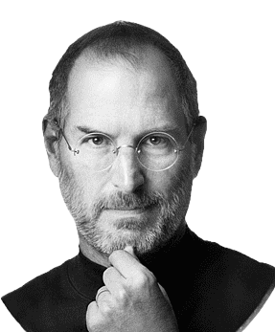
The term “Reality Distortion Field” (RDF) is a phrase to describe Steve Jobs’ ability to convince himself and others to believe in almost anything, even in the face of impossible odds or evidence to the contrary.

Slide 7
The Reality Distortion Field refers to Jobs’ combination of charisma, passion, persuasion, and vision that made him an irresistible force, but somewhat distasteful to the modern eye despite his achievements.

Slide 8
The Biggest lie ever told
The Incident:
In January 1998, Bill Clinton, then-President of the United States, famously made the ‘Clinton Denial’
The statement was in response to allegations of an extramarital affair with Monica Lewinsky, a 22 year-old White House intern.
Became widely known as the “Lewinsky Scandal”
Key Context:
Impeachment Risk: The statement became pivotal in the investigation led by Independent Counsel Kenneth Starr, which aimed to uncover misconduct by Clinton.
Perjury Accusation: Clinton’s denial under oath led to accusations of perjury, which formed the basis for his later impeachment by the House of Representatives.
The Political Climate:
1990s Partisan Divide: The U.S. political landscape was deeply polarized, with Republicans seeking to capitalize on Clinton’s vulnerabilities.
Moral Conservatism: The 1990s were marked by a strong focus on personal morality in politics, with high public scrutiny of politicians’ private lives.
Cultural Change: The rise of 24-hour news cycles and tabloids (e.g., Drudge Report) amplified scandals and created a media frenzy.
Impact on Public Opinion:
While the scandal shocked many, Clinton’s approval ratings remained high, as the public often separated his personal behavior from his political performance.
Many viewed the investigation as excessively partisan, fueling debates about privacy and accountability in public office.
Context and Setting
Press conference about after-school care
Impromptu denial tacked on at end
High stakes political environment
Media presence and cameras
The Impact of the ‘Clinton Scandal’ on Monica Lewinsky
Power Imbalance:
As a young intern, she was vulnerable to the dynamics of authority and trust in the workplace.
Public Shaming and Media Exploitation:
Relentless media coverage turned her into a caricature, stripping her of dignity and agency.
Misogyny amplified the scrutiny, with her bearing the brunt of societal blame.
The Impact of the ‘Clinton Scandal’ on Monica Lewinsky 2
Societal Judgment and Stigma:
She became a symbol of scandal, enduring widespread slut-shaming and societal alienation.
Her name was unfairly reduced to a single event, erasing her complexity as a person.
Psychological and Emotional Impact:
The betrayal, humiliation, and loss of privacy caused deep emotional trauma.
She faced depression and suicidal thoughts as a result of the public vilification.
The Impact of the ‘Clinton Scandal’ on Monica Lewinsky 3
Professional Consequences:
The scandal overshadowed her career prospects, leaving her with limited opportunities.
Legacy and Redemption:
While initially treated as a cautionary tale, Lewinsky has since reclaimed her voice, becoming an advocate for anti-bullying and reflecting on the harm of public shaming.
Monica Lewinsky’s Perspective on the Clinton Affair
Personal Regret and Accountability
Lewinsky has expressed regret for her involvement, recognizing her actions as influenced by youthful infatuation and emotional needs.
Power Imbalance and Consent
Over time, she has come to see the relationship through the lens of power dynamics, acknowledging the impact of Clinton’s authority and her vulnerability.
Monica Lewinsky’s Perspective on the Clinton Affair 2
Public Shaming and Cyberbullying
As one of the earliest victims of global public shaming, Lewinsky has highlighted the intense scrutiny she faced and its effects on her mental health, leading her to advocate against cyberbullying.
Societal Hypocrisy and Double Standards
Lewinsky critiques the double standards, noting the harsher judgment she faced compared to Clinton and how society often disproportionately blames women in cases of moral impropriety.
Monica Lewinsky’s Perspective on the Clinton Affair 3
Reclaiming Her Narrative
Through writing, speaking, and advocacy, Lewinsky has worked to reclaim her story, focusing on resilience and empowering others to overcome public shaming.
The Biggest Lie Ever Told
The Biggest Lie Ever Told
Global Scale and Media Coverage
The lie reached millions globally, with real-time media coverage and international scrutiny.
Breach of Public Trust
Clinton’s lie as a head of state under oath broke public trust, fostering widespread cynicism toward political leaders.
Legal Repercussions and Impeachment
Clinton’s denial led to charges of perjury and impeachment, a rare and profound consequence.
The Biggest Lie Ever Told
Psychological and Cultural Impact
The scandal prompted debates on public and private morality, influencing society’s view on honesty in leadership.
Iconic Language and Lasting Legacy
The phrasing became iconic, making it a memorable cultural phenomenon and embedding it in public consciousness.
The impact on Deception Research
The ‘Clinton Denial’ became the Prototype of high-stakes deception.
At the time, media pored over every frame, but the science and the technology was basic
Later ‘ground-truth’ was established. The Blue Gap Cocktail Dress and an admission.
The Clinton Denial became the ‘Touchstone’ for deception detection and case study.
The consequences of 9/11
There was a noticeable increase in funding for anti-deception research in the aftermath of 9/11
To say this was ‘frenzied’ may seem like exaggeration
Illustrative Interpretation:
Clinton’s denial can be “read” as a crafted narrative intended to manage his political survival, balancing legal precision with an attempt to appear sincere.
The audience’s interpretation depends on the interplay between the words, the delivery, and the cultural expectations of honesty.
Deception overview
Deception is complex and multifaceted
Traditional focus on stereotypical nonverbal behaviour is ineffective
No single ‘Pinocchio’s Nose’ exists
Need for multimodal analysis approach and embracing of contextual complexity

Slide 9
The Clinton Lie: Multimodal Signals
1. Linguistic Dynamics
Shift from policy language to defensive language
Use of definitive phrases (“I did not have…”)
Distancing language (“that woman”)
Pronoun emphasis (“I never told anybody…”)

Slide 10
Thank you very much. First, let me thank all of you who are here. Many of us have been working together now for 20 years on a lot of these issues, and this is a very happy day for us.
I thank the First Lady for all she has done on this issue for as long as I have known her. I thank the Vice President and Mrs. Gore for their family conference and the light it has shed on the announcement we’re here to emphasize today. Thank you, Secretary Riley, for the community learning centers, and I’m very proud of what we’ve done there.
Thank you, Bill White. I’ll talk more about your contribution in a moment, but it is truly remarkable. I thank Rand and Debra Bass for giving us a living, breathing example of the best of America: parents who are working hard to do their jobs but also determined to do their most important job very well with their children. I thank Senator Feinstein, Senator Dodd, and Senator Boxer for being here.
Tomorrow, in the State of the Union Address, I will spell out what we seek to do on behalf of our children to prepare them for the 21st century. But I want to talk a little bit about education today and about this announcement in that context.
Education must be our Nation’s highest priority. Last year, in the State of the Union Address, I set out a 10-point plan to move us forward and urged the American people to make sure that politics stops at the schoolhouse door. Well, we’ve made a lot of progress on that 10-point plan: a remarkable array of initiatives to open the doors of college to every American who’s willing to work for it; strong progress toward high national standards in the basics, the America Reads challenge to teach every 8-year-old to read; continued progress in the Vice President’s program to hook up all of our classrooms and libraries to the Internet by the year 2000.
This has been the most important year in a generation for education reform. Tomorrow I’ll set out the next steps on our continuing road.
First, I will propose the first-ever national effort to reduce class size in the early grades. Hillary and I worked very hard 15 years ago now to have very strict class sizes at home in the early grades, and it was quite controversial and, I think, enormously beneficial when we did it. Our balanced budget will help to hire 100,000 teachers who must pass State competency tests but who will be able to reduce class size in the first, second, and third grades to an average of 18 nationwide.
Second, since there are more students and there will be more teachers, there must be more classrooms. So I will propose a school construction tax cut to help communities modernize and build new schools.
Third, I will promote a national effort to help schools that follow the lead of the Chicago system in ending social promotion but helping students with summer school and other programs to give them the tools they need to get ahead.
All these steps will help our children get the future they deserve. And that’s why what we’re announcing here is so important as well.
Every child needs someplace to go after school. With after-school programs, we can not only keep our kids healthy and happy and safe, we can help to teach them to say no to drugs, alcohol, and crime, yes to reading, sports, and computers. My balanced budget plan includes a national initiative to spark private sector and local community efforts to provide after-school care, as the Secretary of Education said, to half a million more children.
Now, let me say, in addition to all the positive benefits, I think it’s important to point out that the hours between 3 and 7 at night are the most vulnerable hours for young people to get in trouble, for juvenile crime. There is this sort of assumption that everybody that gets in trouble when they’re young has just already been abandoned. That’s not true. Most of the kids that get in trouble get in trouble after school closes and before their parents get home from work. So in the adolescent years, in the later years, it is profoundly important to try to give kids something to say yes to and something positive to do.
But we can’t do it alone. As I said, our plan involves a public-private partnership. So it has fallen to me to announce that our distinguished guest from the Mott Foundation of Flint, Michigan, has pledged up to $55 million to help ensure that after-school programs supported by Federal funds are of the highest quality. That is an astonishing gift. Thank you, Bill White. Thank you.
We are determined to help Americans succeed in the workplace, to raise well-educated, healthy kids, and to help Americans succeed at the toughest job of all, that of being a parent. And the Mott Foundation has gone a long way toward helping us. I thank them.
Now, I have to go back to work on my State of the Union speech. And I worked on it until pretty late last night. But I want to say one thing to the American people. I want you to listen to me. I’m going to say this again. I did not have sexual relations with that woman, Miss Lewinsky. I never told anybody to lie, not a single time—never. These allegations are false. And I need to go back to work for the American people.
Thank you.

Slide 11
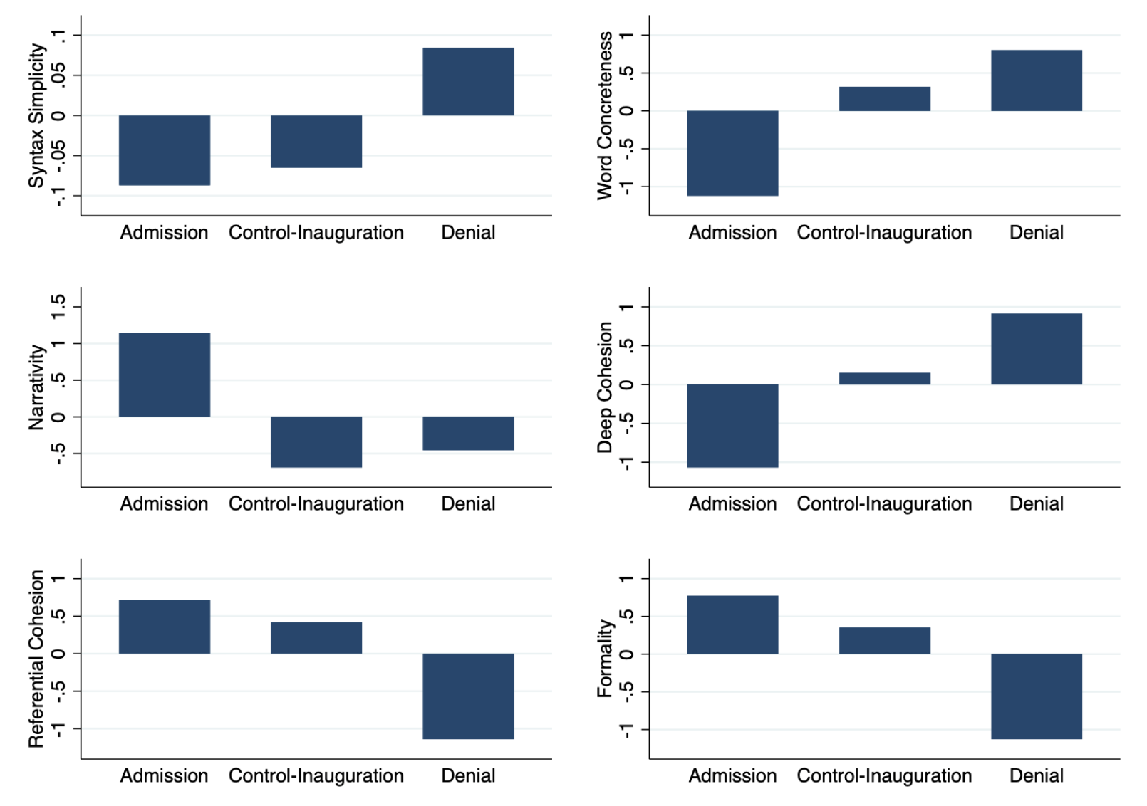
Coh-Metrix
Coh-Metrix is a computational tool designed to analyze the coherence and cohesion of texts. It provides insights into the linguistic, cognitive, and discourse structures of written or spoken text. By leveraging a wide range of metrics, Coh-Metrix helps researchers and educators understand text complexity, readability, and the deeper relationships within language.

Slide 12
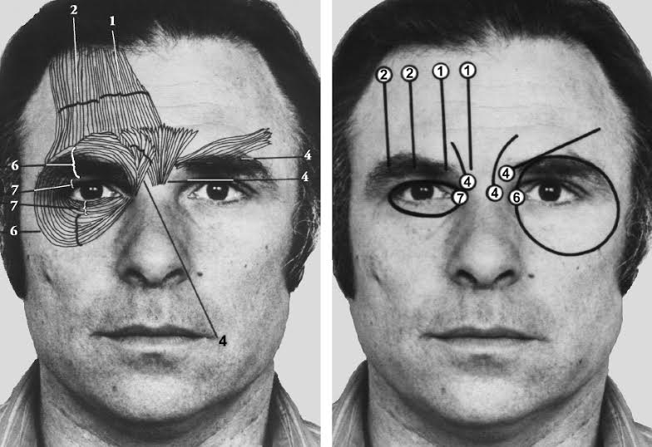
Facial Action Coding System
The Facial Action Coding System (FACS) is a system to taxonimize human facial movements based upon their underlying musculature.
It was first developed by Carl-Herman Hjortsö in 1978 and then popularised and expanded upon by Paul Ekman and Wallace V. Friesen in 2002.

Slide 13
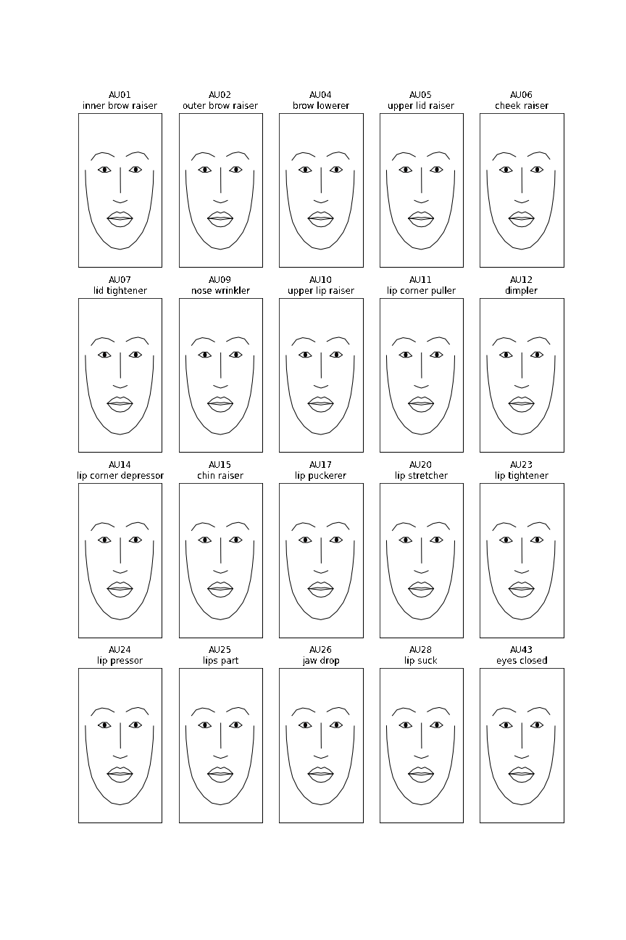

Slide 14
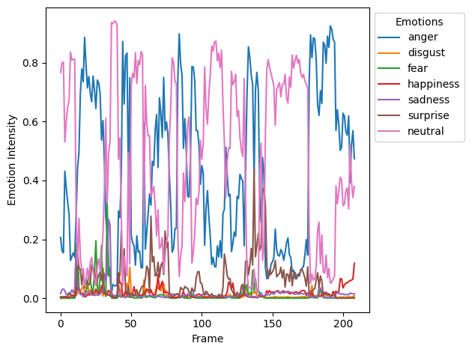

Slide 15
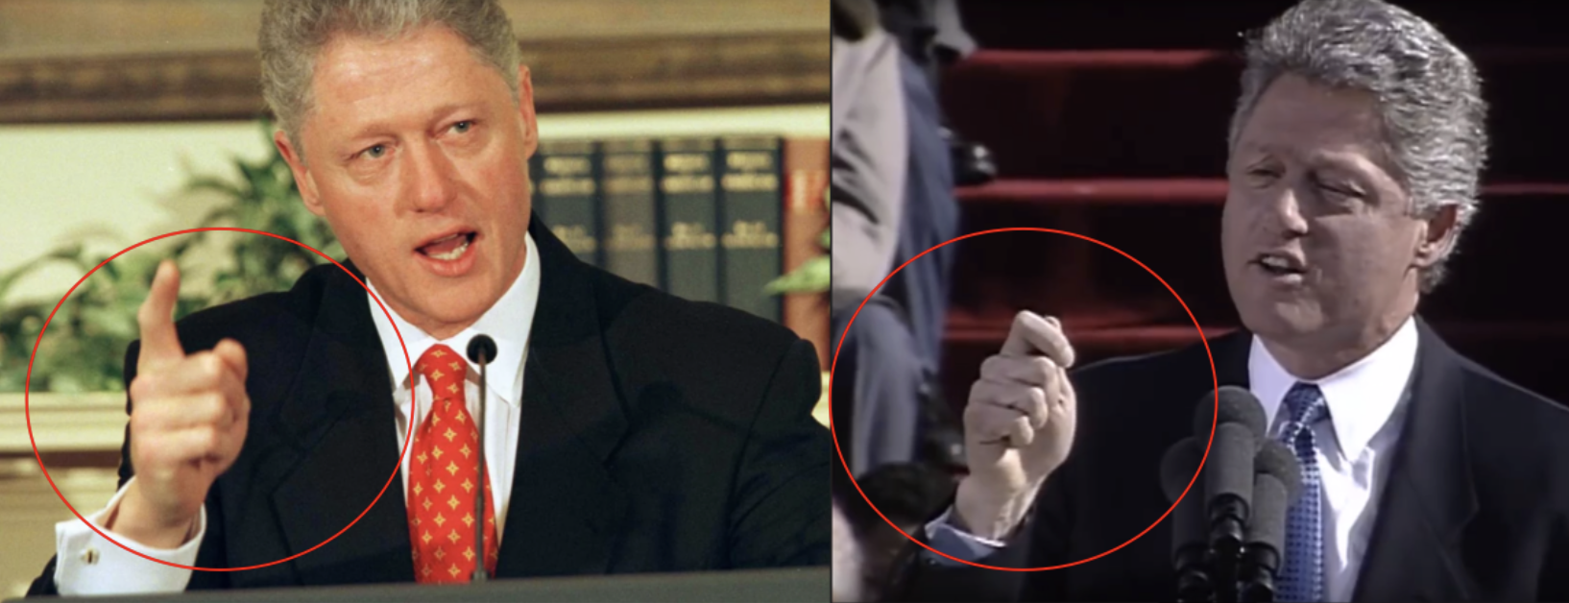
Action Unit Activations (py-feat)
images/au_emotion_animation.mp4
Facial Feature Extraction Overlay (py-feat)
images/overlay_animation_large.mp4
Landmark Animation (py-feat)
images/landmark_animation.mp4
2. Embodied Nonverbal Cues
Aggressive finger pointing (uncharacteristic gesture)
Fixed gaze and eye-widening during denial
Postural changes from policy speech to denial
Breaking from his usual gestural patterns

Slide 16
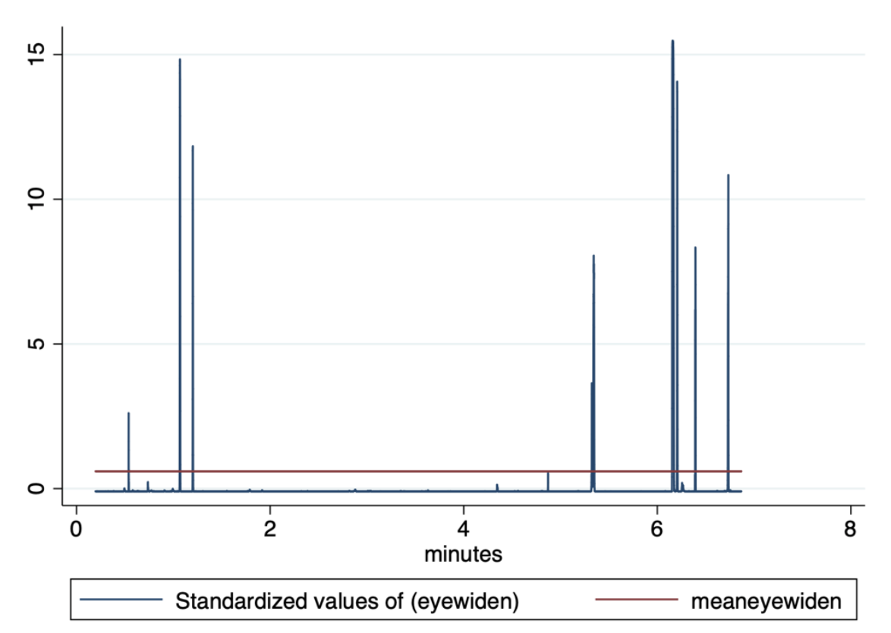

Slide 17
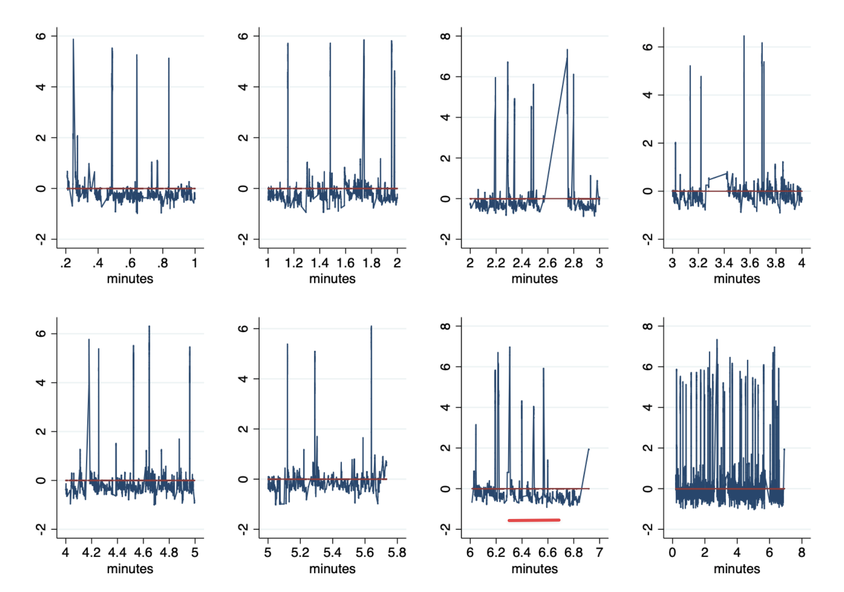
3. Acoustic Changes
Fundamental frequency shifts
Changes in speech rhythm
Doubled rate of pitch peaks during denial
Distinct from baseline speaking pattern

Slide 18
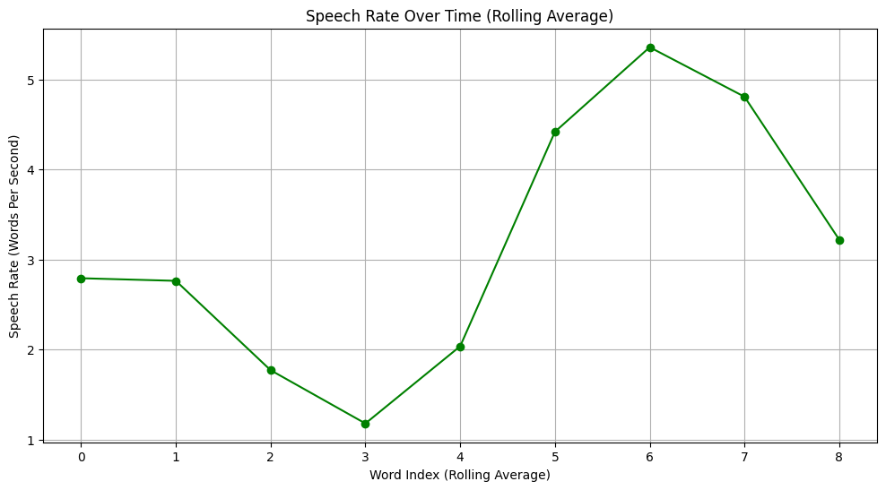

Slide 19
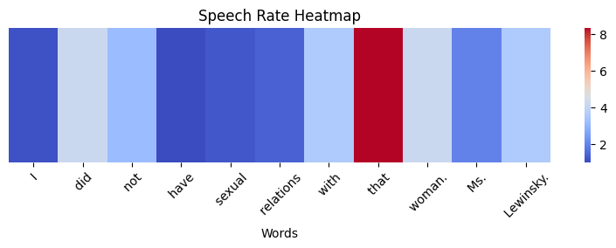

Slide 20
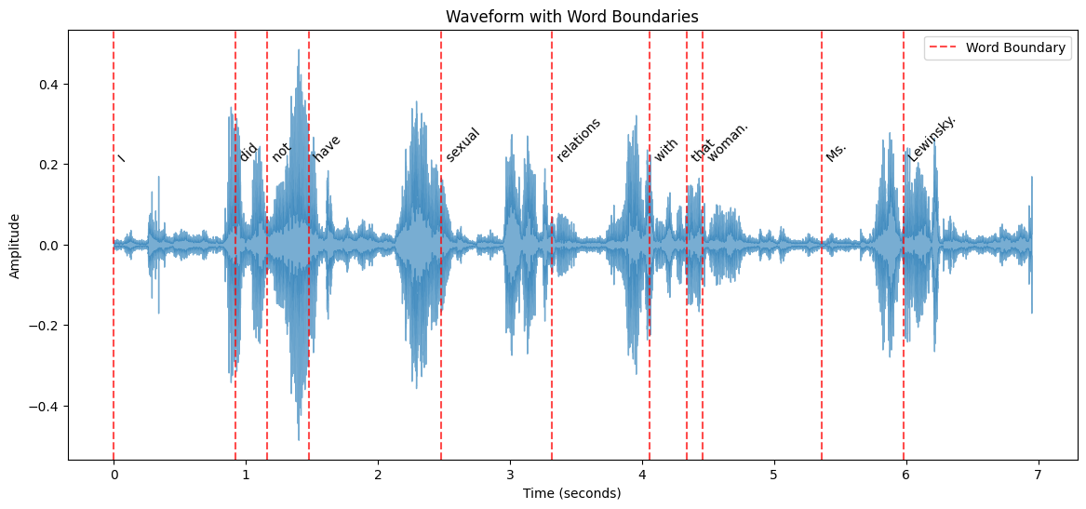

Slide 21
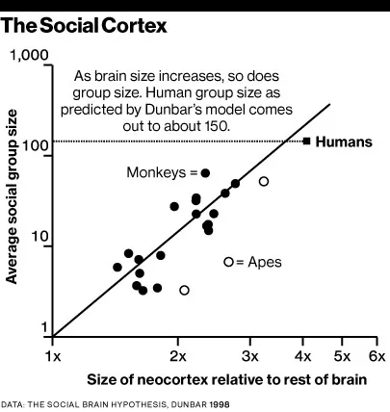
Little Monkey
Dunbar’s Number

Slide 22
The Machiavellian Intelligence Hypothesis
The Machiavellian Intelligence Hypothesis posits that social demands have driven the evolution of the cognitive facilities humans employ to navigate their social domain.
‘Machiavellian’ strategies, such as deception, interpersonal manipulation, cooperation, and alliance formation allow individuals to achieve higher social and reproductive success.

Slide 23
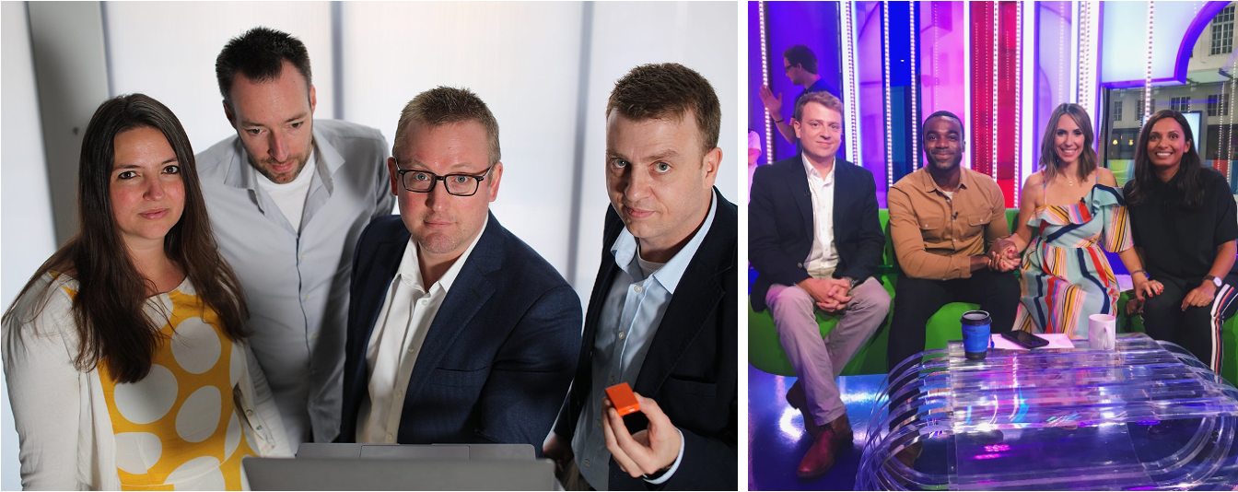
Machiavellian Traits
Strategic manipulation of appearances
Skilled management of power dynamics
Control over social narratives
Calculated use of context
Mastery of asymmetrical relationships
But what about ‘normal’ humans?
BBC Horizon - A Week Without Lying
Goldsmiths Link

Slide 24
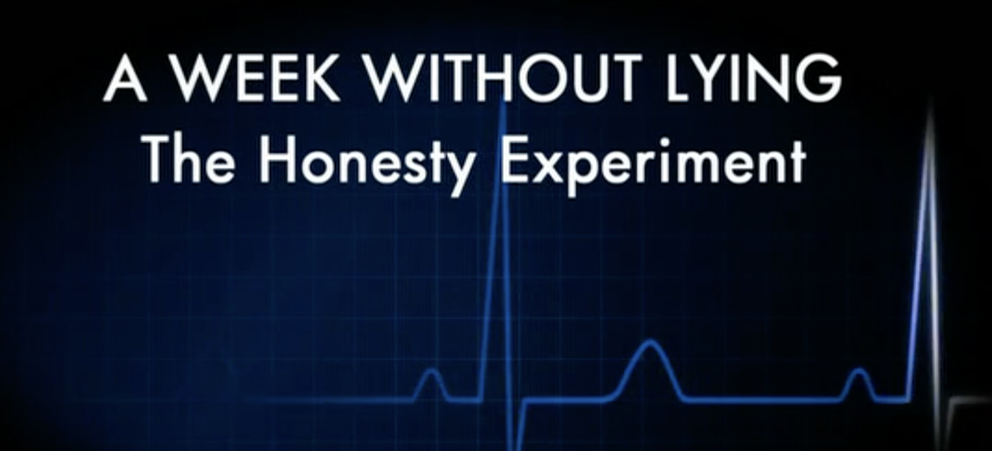

Slide 25
Types of Lies and Their Frequency
Personal Transgression (22%): Cover up a mistake or misdeed.
Economic Advantage (16%): Gain financial benefits through dishonesty.
Personal Advantage (15%): Secure benefits that are not necessarily financial.
Avoidance (14%): Escape or evade interactions with other people.
Self-Impression (8%): Shape a positive image of oneself.
Humour (5%): Make people laugh, often using exaggerated or fictitious elements.
Social or Polite (5%): Uphold social roles or avoid rudeness.
Altruistic (4%): Help someone else by telling a lie.
Malicious (2%): Intentionally hurt others through deception.
Pathological (2%): Disregard for reality; habitual lying without clear reason.
Unknown (7%): Motives are unclear, even to ourselves.

Slide 26
Why Do We Lie?
To Protect Yourself: Many lies are told to avoid negative outcomes for oneself, whether to evade blame or cover up a mistake.
To Promote Yourself: Lies often serve as a means to advance one’s interests, whether for economic or personal benefit.
To Impact Others: Lies can also be intended to influence, entertain, or help others, from humour to altruistic deception.
A new type of lie
What about considering the ‘Future-Truth’ - it’s a lie right now, but by the time anyone finds out, it will be the truth!
To what degree is this a normal aspect of self-presentation and ‘growth’?
Fake it ’til you make it?
Bill Clinton as the Prototype Machiavellian
Masterful Charm and Charisma
Clinton’s charm helped him connect deeply with others, using it as a tool for influence—a core Machiavellian trait.
Strategic Adaptability
He showed flexibility in adapting to scandals and challenges, focusing on maintaining control and favorable outcomes.
Calculated Risk-Taking
Clinton took high-stakes risks, characteristic of Machiavellians, who weigh costs and benefits to achieve personal success.
Political Manipulation and Persuasion
Known for “Clintonian triangulation,” he skillfully built alliances, navigated power dynamics, and appealed to both sides.
Bill Clinton as the Prototype Machiavellian 3
Instrumental Rationality
His pragmatic approach prioritized effective outcomes over ethical consistency, focusing on what was politically advantageous.
Effective Management of Public Image
Clinton maintained a favorable public image despite controversies, displaying expert self-presentation skills.
Boundary Between Public and Private Morality
Demonstrating psychological compartmentalization, he separated personal actions from his public role, a typical Machiavellian characteristic.
The Five Factor Machiavellian Inventory Dimensions
Antagonism - Represents traits associated with hostility, selfishness, and disregard for others. It includes behaviors like manipulation, callousness, immodesty, and cynicism. Antagonistic individuals prioritize their own needs and goals, often at the expense of others, and may lack empathy or compassion.
Agency - Refers to traits related to ambition, self-confidence, and assertiveness. High agency reflects a strong sense of competence, goal-directed behavior, and the ability to influence and lead. People with high agency are self-assured, persistent, and less prone to self-doubt.
Planfulness - Involves strategic thinking, organization, and deliberation. Planful individuals are methodical, prefer structure, and think through decisions before acting. Low planfulness, on the other hand, reflects impulsivity, spontaneity, and a lack of foresight or organization.
Clinton’s Performance
Observable Markers:
Self-Promotional Elements
“I need to go back to work for the American people”
Emphasis on presidential duties
Policy-focused framing
Control Mechanisms
Controlled speaking environment
Managed media access
Structured response format
Achievement Focus
Policy accomplishments highlighted
Leadership role emphasized
Status reinforcement
Planful Elements:
Context Selection
Policy speech backdrop
Controlled environment
Limited Q&A opportunity
Message Construction
Categorical denial
Moral indignation
Policy pivot available
Risk Management
Legal language choice
Witness implications minimized
Future defense prepared
Antagonistic or aversive Elements:
Assertive Behaviors
Finger pointing
Direct eye contact
Strong vocal tone
Status Signaling
Presidential setting
Authority symbols
Formal presentation
Social Influence
Emotional appeals
Credibility cues
Trust leveraging
References
General Deception Theory and Detection
Ekman, P. (1985). Telling lies: Clues to deceit in the marketplace, politics, and marriage. W. W. Norton.
Vrij, A. (2008). Detecting lies and deceit: Pitfalls and opportunities (2nd ed.). Wiley.
Zuckerman, M., DePaulo, B. M., & Rosenthal, R. (1981). Verbal and nonverbal communication of deception. Advances in Experimental Social Psychology, 14, 1-59.
Bond, C. F., & DePaulo, B. M. (2006). Accuracy of deception judgments. Personality and Social Psychology Review, 10(3), 214-234.
DePaulo, B. M., Lindsay, J. J., Malone, B. E., Muhlenbruck, L., Charlton, K., & Cooper, H. (2003). Cues to deception. Psychological Bulletin, 129(1), 74-118.
Deception in High-Stakes Scenarios
Frank, M. G., & Ekman, P. (1997). The ability to detect deceit generalizes across different types of high-stake lies. Journal of Personality and Social Psychology, 72(6), 1429-1439.
ten Brinke, L., Porter, S., & Baker, A. (2012). Darwin the detective: Observable facial muscle contractions reveal emotional high-stakes lies. Evolution and Human Behavior, 33(4), 411-416.
Vrij, A., Mann, S., & Fisher, R. P. (2006). An empirical test of the Behaviour Analysis Interview. Law and Human Behavior, 30(3), 329-345.
Multimodal Deception Detection
Burgoon, J. K., Guerrero, L. K., & Floyd, K. (2016). Nonverbal communication. Routledge. (Chapter on deception cues)
Meservy, T. O., Jensen, M. L., Kruse, J., Burgoon, J. K., & Nunamaker, J. F. (2005). Deception detection through automatic, unobtrusive analysis of nonverbal behavior. IEEE Intelligent Systems, 20(5), 36-43.
Pérez-Rosas, V., Abouelenien, M., Mihalcea, R., & Burzo, M. (2015). Deception detection using real-life trial data. Proceedings of the 2015 ACM on International Conference on Multimodal Interaction, 59-66.
Linguistic Indicators of Deception
Hancock, J. T., Curry, L., Goorha, S., & Woodworth, M. (2008). On lying and being lied to: A linguistic analysis of deception in computer-mediated communication. Discourse Processes, 45(1), 1-23.
Pennebaker, J. W., Francis, M. E., & Booth, R. J. (2001). Linguistic inquiry and word count: LIWC 2001. Lawrence Erlbaum Associates.
Newman, M. L., Pennebaker, J. W., Berry, D. S., & Richards, J. M. (2003). Lying words: Predicting deception from linguistic styles. Personality and Social Psychology Bulletin, 29(5), 665-675.
Deception and Power Dynamics
Hyman, R. (1989). The psychology of deception. Annual Review of Psychology, 40, 133-154.
O’Sullivan, M., & Ekman, P. (2004). The wizards of deception detection. In Granhag, P. A., & Strömwall, L. A. (Eds.), The detection of deception in forensic contexts (pp. 269-286). Cambridge University Press.
Porter, S., & ten Brinke, L. (2010). The truth about lies: What works in detecting high-stakes deception? Legal and Criminological Psychology, 15(1), 57-75.
Deception in Political and Social Contexts
Levine, T. R. (2014). Duped: Truth-default theory and the social science of lying and deception. University of Alabama Press.
McCornack, S. A., & Levine, T. R. (1990). When lovers become leery: The relationship between suspicion and accuracy in detecting deception. Communication Monographs, 57(3), 219-230.
Buller, D. B., & Burgoon, J. K. (1996). Interpersonal deception theory. Communication Theory, 6(3), 203-242.
4E Cognitive Science Model
Clark, A. (1997). Being there: Putting brain, body, and world together again. MIT Press.
Varela, F. J., Thompson, E., & Rosch, E. (2017). The embodied mind: Cognitive science and human experience. MIT Press.
Truthiness and Post-Truth Era
Colbert, S. (2005). Truthiness. The Colbert Report.
McIntyre, L. C. (2018). Post-truth. MIT Press.
Reality Distortion Field and Steve Jobs
Isaacson, W. (2011). Steve Jobs. Simon & Schuster.
Schein, E. H. (2010). Organizational culture and leadership (4th ed.). Jossey-Bass.
The Clinton Scandal and Public Trust
Harris, R. (2009). Political scandal: Power and visibility in the media age. Polity.
Sabato, L. (1998). Feeding frenzy: How attack journalism has transformed American politics (Rev. ed.). Free Press.
Impact on Monica Lewinsky
Lewinsky, M. (2015). The price of shame [TED talk]. Retrieved from https://www.ted.com/talks/monica_lewinsky_the_price_of_shame
Mullany, L. (2007). Gendered discourse in the professional workplace. Palgrave Macmillan.
Deception Research and the Clinton Denial
Vrij, A. (2008). Detecting lies and deceit: Pitfalls and opportunities (2nd ed.). Wiley.
Ekman, P. (2009). Telling lies: Clues to deceit in the marketplace, politics, and marriage (4th ed.). Norton.
Machiavellian Intelligence Hypothesis
Whiten, A., & Byrne, R. W. (Eds.). (1997). Machiavellian intelligence II: Extensions and evaluations. Cambridge University Press.
Wilson, D. S., Near, D., & Miller, R. R. (1996). Machiavellianism: A synthesis of the evolutionary and psychological literatures. Psychological Bulletin, 119(2), 285-299.
Facial Action Coding System (FACS)
Ekman, P., & Friesen, W. V. (2003). Unmasking the face: A guide to recognizing emotions from facial clues. Malor Books.
Cohn, J. F., & Ekman, P. (2005). Measuring facial action. In J. A. Harrigan, R. Rosenthal, & K. Scherer (Eds.), The new handbook of methods in nonverbal behavior research (pp. 9-64). Oxford University Press.
Dunbar’s Number
Dunbar, R. I. M. (1992). Neocortex size as a constraint on group size in primates. Journal of Human Evolution, 22(6), 469-493.
Dunbar, R. I. M. (2010). How many friends does one person need? Dunbar’s number and other evolutionary quirks. Faber & Faber.
FFMI (Five Factor Machiavellian Inventory)
Austin, E. J., Farrelly, D., Black, C., & Moore, H. (2007). Emotional intelligence, Machiavellianism, and emotional manipulation: Does EI have a dark side? Personality and Individual Differences, 43(1), 179-189.
Jones, D. N., & Paulhus, D. L. (2014). Introducing the Short Dark Triad (SD3): A brief measure of dark personality traits. Assessment, 21(1), 28-41.
Media Influence on Scandal Perception
Iyengar, S., & Kinder, D. R. (1987). News that matters: Television and American opinion. University of Chicago Press.
Zaller, J. (1992). The nature and origins of mass opinion. Cambridge University Press.
Tools
py-feat
Cheong, J. H., Brooks, S., & Chang, L. J. (2021). py-feat: Python Facial Expression Analysis Toolbox. Journal of Open Source Software, 6(57), 3085. https://doi.org/10.21105/joss.03085
GitHub: py-feat GitHub Repository
Notes: py-feat is a Python package that allows for the extraction and analysis of facial expressions, using machine learning models to infer emotions from images and videos.
OpenFace
Baltrušaitis, T., Robinson, P., & Morency, L. P. (2016). OpenFace: An open source facial behavior analysis toolkit. 2016 IEEE Winter Conference on Applications of Computer Vision (WACV), 1-10. https://doi.org/10.1109/WACV.2016.7477553
GitHub: OpenFace GitHub Repository
Notes: OpenFace is an open-source tool for facial landmark detection, head pose tracking, and facial action unit recognition, which makes it an excellent tool for nonverbal analysis in behavioral studies.
OpenPose
Cao, Z., Hidalgo, G., Simon, T., Wei, S. E., & Sheikh, Y. (2019). OpenPose: Realtime Multi-Person 2D Pose Estimation using Part Affinity Fields. IEEE Transactions on Pattern Analysis and Machine Intelligence, 43(1), 172-186. https://doi.org/10.1109/TPAMI.2019.2929257
GitHub: OpenPose GitHub Repository
Notes: OpenPose is a popular library for real-time human pose estimation that can detect multiple body parts in images or videos, making it useful for studying body language and nonverbal behavior.
Praat
Boersma, P., & Weenink, D. (2023). Praat: Doing phonetics by computer [Computer program]. Version 6.3. http://www.praat.org
Notes: Praat is a widely-used software for the analysis of speech in phonetics, providing a range of tools for acoustic analysis, formant extraction, pitch detection, and speech annotation.
GitHub Alternative: While Praat itself is not hosted on GitHub, you can find wrappers for Python, such as PraatIO on GitHub.
Linguistic Inquiry and Word Count (LIWC) - Paywall - see notes below.
Pennebaker, J. W., Boyd, R. L., Jordan, K., & Blackburn, K. (2015). The development and psychometric properties of LIWC2015. University of Texas at Austin. https://liwc.wpengine.com/
Notes: LIWC is a text analysis software that quantifies linguistic features to assess the psychological, cognitive, and emotional states of speakers or writers. It is not directly available on GitHub, but there are open-source alternatives and related projects, such as LIWCalike in R.

